Slide 1
The Battle of the Neighborhoods
Applied Data Science Capstone by IBM/Coursera

Slide 2
The Problem
Introduction

Slide 3
The Problem
This project aims to select the safest streets in Barcelona based on the total accidents, explore the districts of that neighbourhood to find the most accidental streets in each neighbourhood and finally cluster the districts using k-mean clustering.
This report will be targeted to people such as myself who are looking to the safest routes for driving. In order to choose a neighborhood to drive, safety is considered as a concern when moving around my city. The accidents statistics will provide an insight into this issue.

Slide 4
Scouting for a data set
Data Acquisition: Data sets from the Open Data BCN portal, the Ajuntament de Barcelona's open data service.
Open Data BCN, a project that was born in 2010, implementing the portal in 2011, has evolved and is now part of the Barcelona Ciutat Digital strategy, fostering a pluralistic digital economy and developing a new model of urban innovation based on the transformation and digital innovation of the public sector and the implication among companies, administrations, the academic world, organizations, communities and people, with a clear public and citizen leadership.

Slide 5





Table of contents
Data
Methodology
Analysis
Results and discussion
Conclusion

Slide 6
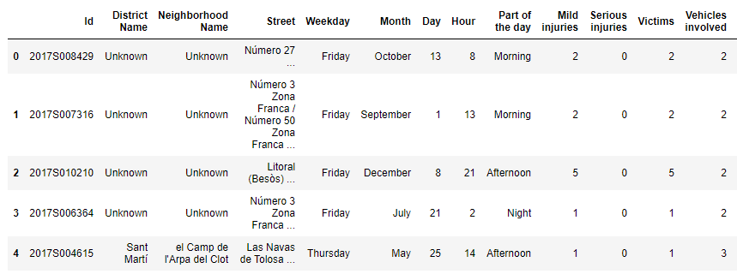
Data Exploration and Cleaning
Our data set contains the list of accidents handled by the local police in the city of Barcelona. Incorporates the number of injuries by severity, the number of vehicles and the point of impact.
Some accidents occurred are informed as ‘Unknown’ District and Neighborhood Name. These will require a cleaning task.

Slide 7
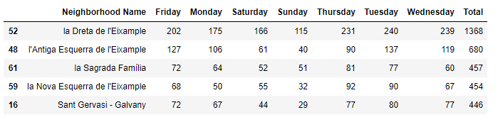
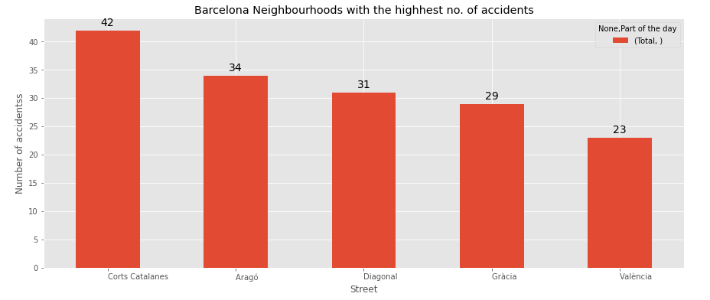
Methodology
Summary of accidents
Graphic description
Summary of top 5 nenighborhoods with most accidents by days of the week.
Top 5 streets in Barcelona with most accidents.

Slide 8
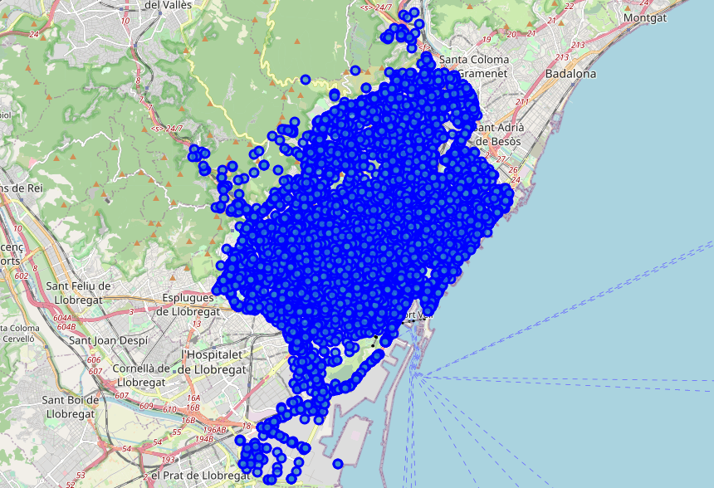
Analysis
This is the map where the all the accidents happened.
We will proceed to create clusters in order to distinguish the different type of areas.

Slide 9
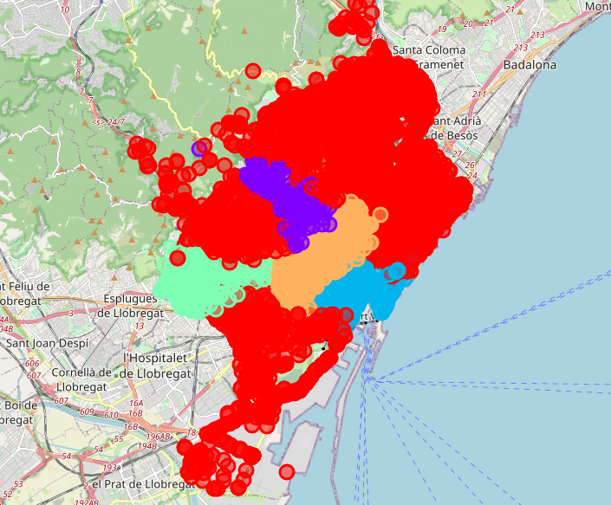
Results and discussion
Clustering Barcelona
Interpretation
This is the clustering map for k=5 that show us the different areas according to how ‘accidentals’ those have been.
The clusters suggest that crossing the city through its insides, like Diagonal Street, or all the way up, from or towards the Port, is potentially more risky compared to the other routes around. In case you drive from outside the city, it might seem relevant to choose from which side to approach instead of reaching the city from the middle and then reroute.

Slide 10

Conclusion
The aim of this project is to help people who want to drive at the less accidental streets in Barcelona.
This project helps any driver to get a better understanding of the traffic inside the city of Barcelona and how important it is, not only taking the fastest route, but the potentially safest for the passengers.

Slide 11
Thanks

